Slide 1
PIP4004: UNIVERSITY PROJECT Review-0 Presentation DEVELOPMENT OF A GAMIFIED PLATFORM ON CHILDREN’S RIGHTS
Batch Number:
Under the Supervision of,
Ms. Radhika Sreedharan
Assistant Professor
School of Computer Science and Engineering
Presidency University
Roll Number | Student Name
20211CST0033 | MAIMOONA MAHMOOD
Name of the Program: B.Tech. Computer Science & Technology
Name of the HoD: Saira Banu Atham
Name of the Program Project Coordinator: Dr. Manjula HM
Name of the School Project Coordinators: Dr. Sampath A K / Dr. Abdul Khadar A / Mr. Md Ziaur Rahman

Slide 2
Content
Problem Statement
Github Link
Analysis of Problem Statement
Timeline of the Project
References

Slide 3
Problem Statement Number: PSCS_4
Organization: Ministry of Law and Justice
Category : Software
Problem Description: Development of gamified platform on Children's Rights to increase legal literacy and awareness among children in India.
Difficulty Level: Simple

Slide 4
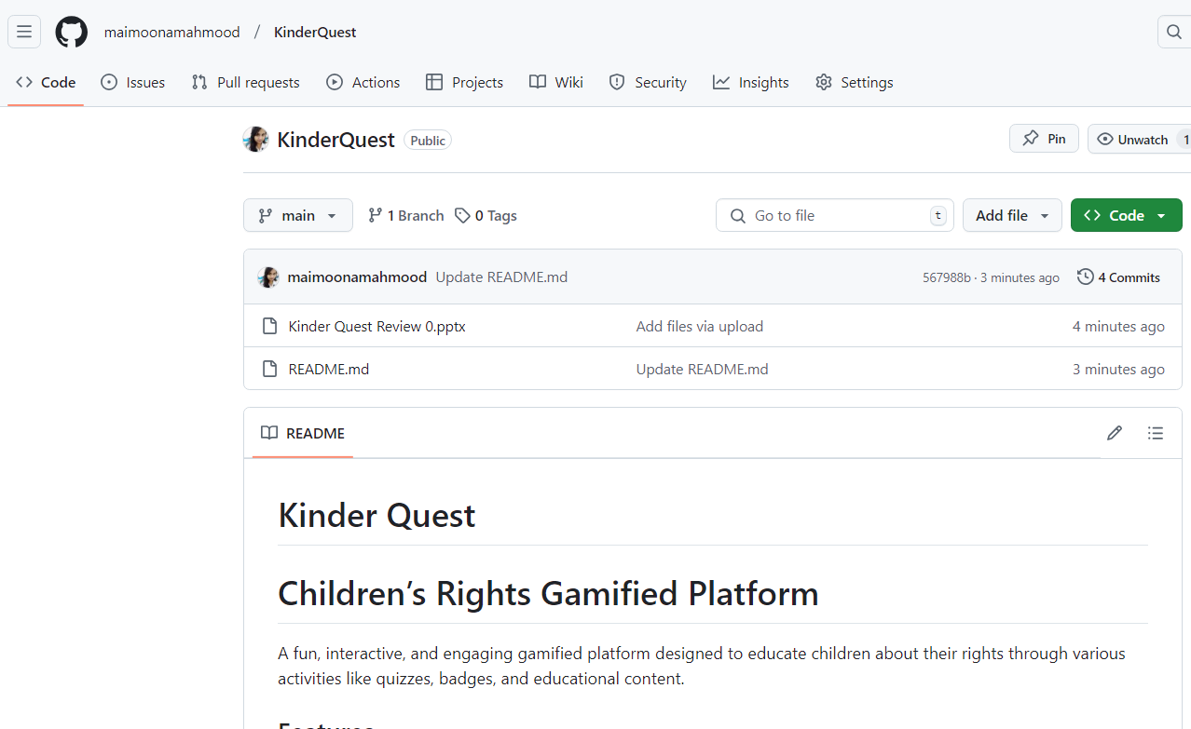
Github Link:
GitHub Link:
https://github.com/maimoonamahmood/KinderQuest

Slide 5
Analysis of Problem Statement
Technology Stack Components:
✅ HTML – Structure of the website ✅ CSS – Styling and animations ✅ Bootstrap – For responsive design and UI components ✅ JavaScript– For interactive quizzes and gamification
✅ Canva / Figma – For UI designing
✅ GitHub Pages – For deployment

Slide 6
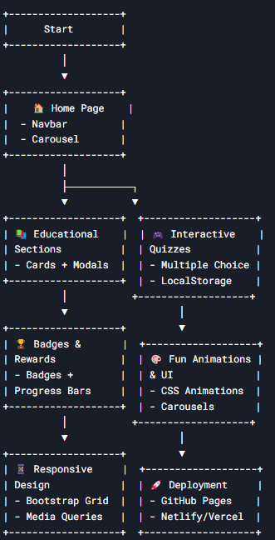
Analysis of Problem Statement (contd...)
HTML, CSS, Bootstrap
JS for interactive learning
UI Designing: Canva / Figma
Bootstrap, CSS

Slide 7
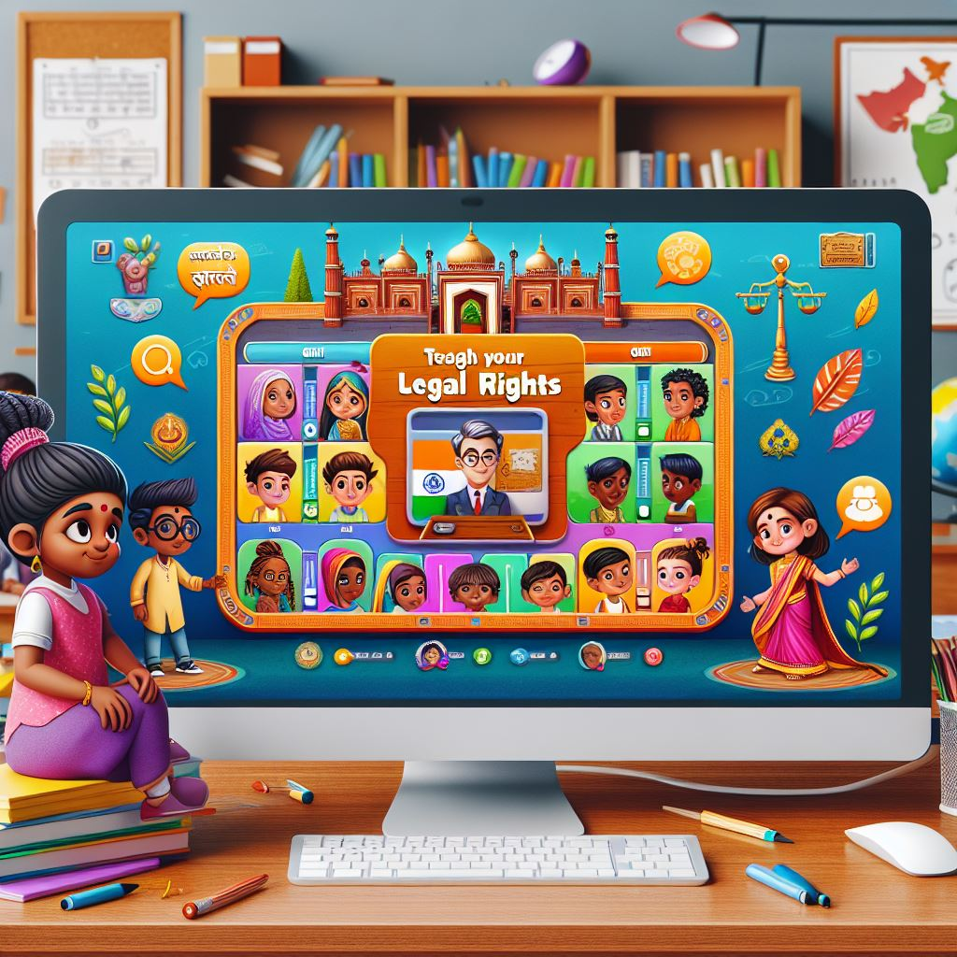
Analysis of Problem Statement (contd...)
This platform will be a web application that uses gamification techniques to make learning about children’s rights fun and interactive. Instead of traditional text-based education, it will involve quizzes, storytelling, role-playing scenarios, rewards, and interactive challenges to teach children about their rights in an engaging way.

Slide 8
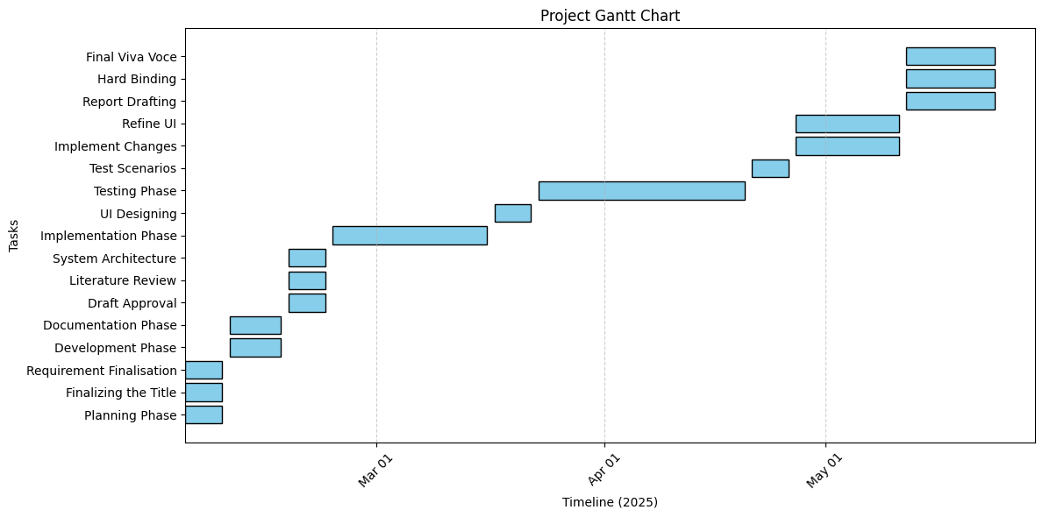
Timeline of the Project (Gantt Chart)

Slide 9
References (IEEE Paper format)
Gamification in Education D. Dicheva, C. Dichev, G. Agre, and G. Angelova, "Gamification in Education: A Systematic Mapping Study," Journal of Educational Technology & Society, vol. 18, no. 3, pp. 75–88, 2015. Available: https://www.jstor.org/stable/jeductechsoci.18.3.75
Smart Education and Interactive Learning M. U. Farooq, A. Waseem, S. Mazhar, A. Khairi, and T. Kamal, "A Review on Internet of Things (IoT) for Smart Education: Concept, Applications, and Challenges," IEEE Access, vol. 8, pp. 209201–209219, 2020. DOI: 10.1109/ACCESS.2020.3038818.

Slide 10
References (IEEE Paper format)
Gamification for Children's Learning A. I. Wang, "The Wear Out Effect of a Game-Based Student Response System," Computers & Education, vol. 82, pp. 217–227, 2015. DOI: 10.1016/j.compedu.2014.11.004.
Interactive Platforms for Children S. Papadakis and M. Kalogiannakis, "Using Gamification for Supporting an Introductory Programming Course: The Case of ClassCraft in a Secondary Education Classroom," Interactive Technology and Smart Education, vol. 14, no. 4, pp. 272–290, 2017. DOI: 10.1108/ITSE-05-2017-0028.

Slide 11
References (IEEE Paper format)
Gamification and Human Rights Education K. Kiili, "Digital Game-Based Learning: Towards an Experiential Gaming Model," Internet and Higher Education, vol. 8, no. 1, pp. 13–24, 2005. DOI: 10.1016/j.iheduc.2004.12.001.
Smart Education Systems Z. Lv, L. Qiao, and A. K. Singh, "AI-Enabled IoT for Smart Education: Promises and Challenges," IEEE Internet of Things Journal, vol. 8, no. 15, pp. 12345–12358, 2021. DOI: 10.1109/JIOT.2021.3076645.

Slide 12


